Slide 1
NIGERIA CARES
Covid-19 Action Recovery and Economic Stimulus
Program for Results
Project Launch Workshop
December 6, 2021
CARES Fiduciary Team (Procurement)

Slide 2
Outline
Procurement Approach at the Federal
Procurement Approach at the States
Core Procurement Principles
Procurement-related Fraud and Corruption Risks
Common Red Flags in Procurement
Likely Procurement Issues and Recommended Measures

Slide 3
Procurement Approach at the Federal
Procurement at the FCSU will be implemented through IPF (Investment Project Financing)
IPF implies that all procurement activities under the FCSU and supporting agencies will be governed by the World Bank Procurement Regulation
The major and most critical procurement activity (to be engaged by IERD but managed by FCSU) is the Engagement of the IVA (Independent Verification Agent) which is on-going.
Other procurement activities will include:
    Provision of technical support to states as may be required
    Engagement of the NGF secretariat for peer learning and experience sharing through a single source procurement process
    Procurement of goods such as vehicles, computers, and office equipment for the FCSU

Slide 4
Procurement Approach at the States
Procurement at the States will be implemented through PforR
PforR implies that all procurement activities will be governed by the States’ procurement laws and regulations
Procurement activities at the States will include:
    Works: upgrading of the sanitary infrastructure in markets; improvement in existing agriculture infrastructure
      for canals, feeder roads, and warehouses; and rehabilitation of classroom blocks and primary health care centers;
    Goods: (a) acquisition of solar panels, (b) procurement of farm assets and equipment, and procurement of ICT equipment;
    Consultancies: (a) provision of extension services and training and (b) TA and training on digital payment system.

Slide 5
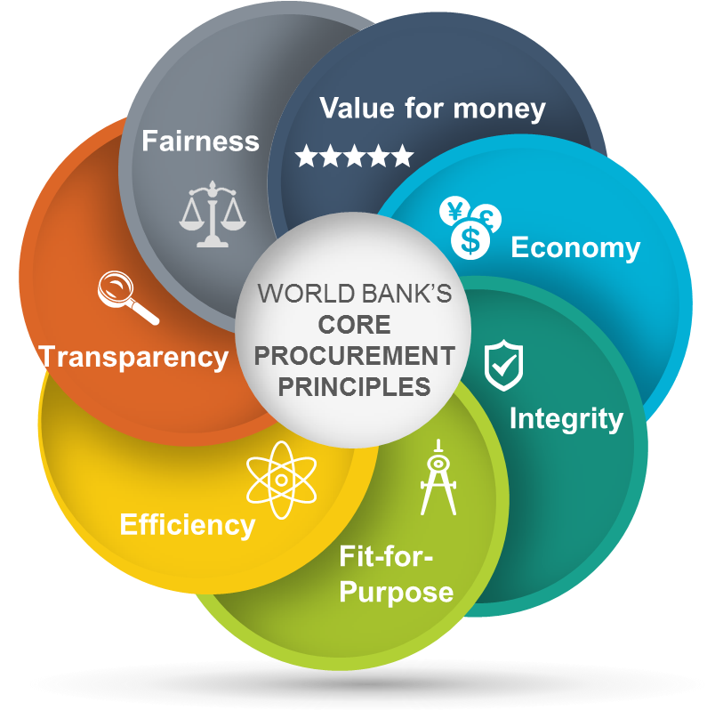
Core Procurement Principles

Slide 6
Core Procurement Principles
Value for Money
The Principle of value for money means the effective, efficient, and economic use of resources. This requires an evaluation of relevant costs and benefits along with an assessment of risks. It may also include non-price attributes and/or life cycle costs. Price alone may not necessarily represent value for money.
Economy
The economy principle takes into consideration factors that support value for money, such as sustainability, quality, and non price attributes and/or life cycle as appropriate. It permits integrating economic, environmental, and social considerations into the procurement process that the Bank agrees to with the Borrower. It also permits augmenting identified sustainability criteria with specific criteria in support of the Borrower’s own sustainable procurement Policy.
Fit for Purpose:
The principle of Fit for Purpose applies both to the intended outcomes and the procurement arrangements. It is used when determining the most appropriate approach to procurement to meet the project development objectives and outcomes, taking into account the context and the risk, value, and complexity, of the procurement.

Slide 7
Core Procurement Principles
Integrity:
The integrity principle refers to the use of funds, resources, assets and authority, according to the intended purposes in a well-informed manner that is aligned with the public interest and broader principles of good governance.
Efficiency:
The principle of efficiency requires that procurement processes be proportional to the value and risks of the underlying project activities. Procurement arrangements are generally time-sensitive and strive to avoid delays.
Transparency:
The principle of transparency requires that the Borrower and the Bank enable appropriate review of the procurement activities, supported by appropriate documentation and disclosure.
Fairness:
The principle of fairness refers to: Equal opportunity and treatment for bidders and consultants.
✓

Slide 8
Fraud and Corruption Risks
Planning and Project Design
Procurement Process
Project Implementation
1. Undue political interference on project selection 2. Biased beneficiary selection 3. Tailored specifications designed to steer contract to favored bidder | 4. Price inflation due to corruption, collusion or reduced competition 5. Selection of less qualified bidders 6. Procurement of unnecessary items 7. Inside information | 8. Payment of inflated or false claims 9. Diversion (e.g., theft and personal use of assets) 10. Ghost workers 11. Non-delivery 12. Substandard work and materials 13. Falsified implementation and audit reports

Slide 9
Overview
Phases when fraud and corruption take place
Planning
Bidding Process
Evaluation
Contract Mgt.
1. Procurement Plan
4. Short-listing and
Prequalification
8. Due Diligence
10. Draft Contract
2. Advertisement
5. Pre-bid Conference
9. Bid Evaluation
11. Contract Delivery
3. Bidding Documents
6. Bid Submission
12. Contract Changes
7. Bid Opening
Typical “no objection” points

Slide 10
1. Procurement Plan
Red flags checklist
Schemes | Red Flags
Unnecessary items | Items in plan are not consistent with project requirements
Unjustified choice of less competitive schedule | Inadequate or misleading justification Award of multiple sole source contracts to same company Excessive use of shopping
Contract splitting | Unusual splits (i.e., items that are usually procured together) Many awards just below review thresholds
Inappropriate bundling | Variety of unrelated goods bundled into one lot significantly reducing the number of potential bidders, especially if the items are not usually bundled and the implementing agency’s justification is poor
Non-compliance | Procurement actions are not in compliance with the plan
Notes:
ACFE Data (Source: 2008 Report to the Nation on Occupational Fraud and Abuse, Association of Certified Fraud Examiners)
Tip (46.2%)
By Accident (20.0%)
Internal Audit (19.4%)
Internal Controls (23.3%)
External Audit (9.1%)
Notified by Police (3.2%)
Please note that the percentage exceeds 100% because in some cases respondents identified more than one detection method.
The full report is available at the following site: http://www.acfe.com/documents/2008-rttn.pdf

Slide 11
1. Procurement Plan
Control checklist
Needs and items procured are appropriate
Business unit has formally requested purchase
Budget for purchase has been verified
Robust needs assessment or needs statement is in place
Technical solutions appear appropriate
Industry capacity is reflected in the procurement plan
Procedure details when and how to undertake industry surveys
Past contracts has been reviewed for procurement insights and performance issues, especially if planned contract is high risk/value
Cost estimates are robust
Estimates are based on a robust methodology are up-to-date
Estimates have proven to be reliable and complete in the past (e.g., compared to prior lowest bids / actual costs)
Estimates have been independently verified by a reputable firm/ consultant
Packages, schedules and sequencing are appropriate
Plan is prepared well in advance of negotiations, covers 18 months, is sufficiently detailed and sequencing is appropriate
Material changes to the plan require client managerial and Bank approval
Agency has a track record of complying with plans
Notes:
ACFE Data (Source: 2008 Report to the Nation on Occupational Fraud and Abuse, Association of Certified Fraud Examiners)
Tip (46.2%)
By Accident (20.0%)
Internal Audit (19.4%)
Internal Controls (23.3%)
External Audit (9.1%)
Notified by Police (3.2%)
Please note that the percentage exceeds 100% because in some cases respondents identified more than one detection method.
The full report is available at the following site: http://www.acfe.com/documents/2008-rttn.pdf

Slide 12
Common Fiduciary Issues in PforR
Weak linkages between the budget and procurement plans
Poor contract management -time and cost overruns
Inadequate record keeping and filing
Quality management and materials testing
Poor procurement reporting and oversight (incl. cost estimation and extensions of time)
Inadequate complaint handing system for complaints including procurement complaints

Slide 13
Recommended Measures for Procurement Issues
Develop a Procurement Strategy to ensure timely delivery of procurement activities
Ensure that experienced Procurement Officers are deployed to each of the procuring entities implementing the Programme
Develop an effective Contract Management System
Maintain a Complaint Handling System for registering procurement-related complaints and their resolution status
Oversight and Procurement Audits to be conducted by the State Procurement Agencies

Slide 14
Thank You

